Slide 1
Europe from without
The global context

Slide 2
The steps in the argument
The immediate context
religion in modern Europe
New arrivals change our perceptions
some examples
The European Enlightenment
a freedom from belief/ as opposed to a freedom to believe
A recent example
the International Panel on Social Progress – see https://www.ipsp.org/

Slide 3
Religion in modern Europe 1
The factors to take into account – there are five, which push and pull in different directions:
cultural heritage
the historic churches – public utilities
a shift from obligation to consumption – growing markets
new arrivals
secular reactions
Drawing these together – to a better understanding of the context in which we are working

Slide 4
Religion in modern Europe 2
Two things are happening at once in (West) Europe
at one and the same time Europeans are becoming both more secular and more religiously diverse
the former is often seen as the privatization of belief; the latter enhances its public profile
As a result we talk more about something that we do less
an ill-informed and ill-mannered public debate
(including the debate about science and religion)

Slide 5
Religion and welfare
State churches and welfare states
Both exist in Europe; neither exist in the US – this is not a coincidence (see below)
Questions of entitlement – who ‘deserves’ welfare?
Different theologies/ ecclesiologies – Lutheran, Catholic, Calvinist and Anglican – underpin different approaches to welfare provision and the role of the state within this
Nordic social democracy; Catholic tensions
the underlying point continues to resonate as the welfare state begins to recede

Slide 6
Religion and mental health
The mental health needs of migrants
Presenting with a religious narrative – the reactions of Western clinicians
is religion necessarily delusional?
discerning the difference between forms of religion which do damage and those which become sources of healing
Nordic examples
The Spirituality and Psychiatry Special Interest Group (SPSIG) within the Royal College of Psychiatry

Slide 7
Religious education
Religion has returned to public debate revealing a worrying loss of religious literacy
In many parts of Europe, renewed attention to an aspect of the curriculum that all too often has been ignored
See the current Commission on Religious Education - http://www.commissiononre.org.uk/
there is much to be done
A greater urgency given the growing realization that secularization in Europe remains an exceptional case

Slide 8
Europe as an exceptional case
The key question: is Europe secular because it modern, or is Europe secular because it is European?
Structural constraints
at every level (national, regional and local) – Europe’s historic churches are embedded in territory
stable or static? The industrial revolution
The European Enlightenment
a freedom from belief
the philosophies of science that underpin the social sciences

Slide 9
American contrasts
Structural differences
the congregation rather than the parish is the core building block – no embedding in territory
migrants who brought their versions of (mostly) Christian religion with them embedded easily into the growing cities of the federal state
an upward spiral; economic, political and religious factors worked together → a vibrant religious market
The American Enlightenment
a freedom to believe

Slide 10
What is Europe not?
it is not a vibrant religious market as is found in the US
it is not a part of the world where Christianity is growing exponentially, often in Pentecostal forms, as is found in the global south
it is not a part of the world dominated by faiths other than Christian, but is increasingly penetrated by these
it is not for the most part subject to the violence often associated with religion and religious difference in other parts of the globe – the more so if religion becomes entangled in political conflict

Slide 12
The Enlightenment and social science
Manuel Vasquez (from El Salvador) – sociology as the epistemological child of the Enlightenment
rationality/ empirical observation – the ultimate sources of knowledge, as opposed to faith and revelation
Drawing on Auguste Comte – the opposition between theology and sociology is central to incipient sociology’s self understanding
Religion as the intellectual and dying ‘other’
Secularization is built into the DNA of the discipline

Slide 13
Does this matter?
Europe
a relatively good fit between sociological thinking about religion and empirical realities, keeping in mind regional variations, growing complexities, and unexpected developments (e.g. London)
The global context
universalizing the theory causes trouble
my/our experience with the IPSP

Slide 14
The International Panel on Social Progress
2015 – an invitation from the IPSP to co-lead (with Nancy Ammerman) the chapter team dealing with religion
the significance of religion as a factor in social progress on a global scale
A marked shift in attitudes amongst those who work in the field of religion
Much less evident in the mainstreams of the social sciences, where European paradigms persist

Slide 15
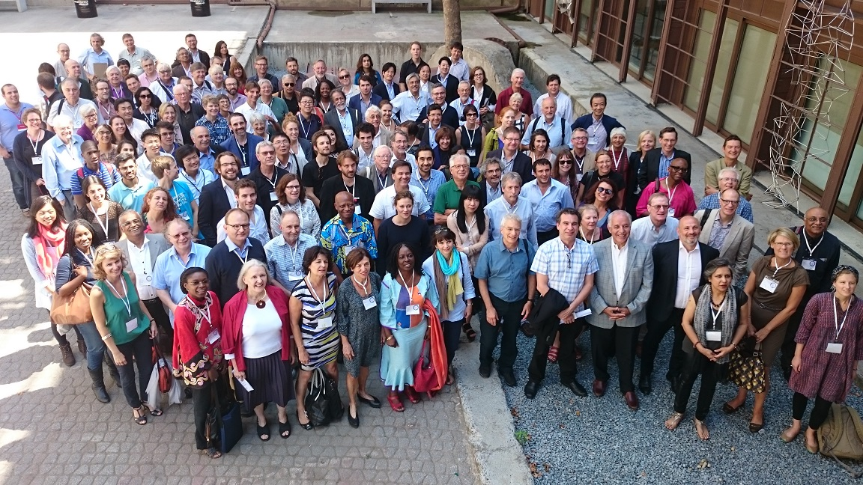

Slide 16
Chapter 16 in the ISSP report 1
Starts from the premise that some 80 percent of the world’s population affirms some kind of religious identification, a proportion that is growing rather than declining
The peak of secularity/ secularism – 1970s
Significant changes in the former Soviet Union and in China
Plus differential birthrates
Note throughout – an emphasis on lived religion, rather than belief as such

Slide 17
Chapter 16 in the ISSP report 2
Emphasizes the significance of belief and practice in everyday lives and local contexts, analyzing the impact of religion and its relevance to social progress in a wide variety of fields:
family, gender and sexuality
diversity and democracy
conflict and peace-making
everyday wellbeing
care for the earth

Slide 18
Further . . .
Argues that researchers and policy makers pursuing social progress will benefit from careful attention to the power of religious ideas to motivate, of religious practices to shape ways of life, of religious communities to mobilize and extend the reach of social change, and of religious leaders and symbols to legitimate calls to action
All of these, however, can be put to either good or ill, for which reason assessment of particular religions in specific contexts is essential

Slide 19
In conclusion
Five interconnected themes:
the persistence of religion in the twenty-first century
the importance of context in discerning outcomes
the need for cultural competence relative to religion
the significance of religion in initiating change
the benefits of well-judged partnerships
A continuing need for critical but appreciative assessment and the demonstrable benefits of creative partnerships

Slide 20
Key references
Grace Davie Religion in Public Life: Levelling the Ground (Theos 2017) https://www.theosthinktank.co.uk/research/2017/10/28/religion-in-public-life-levelling-the-ground
Manuel Vasquez ‘Grappling with the legacy of modernity: Implications for the sociology of religion’, in Courtney Bender et al., Religion on the Edge: De-Centering and Re-Centering in the Sociology of Religion. New York: OUP 2013

