Slide 1
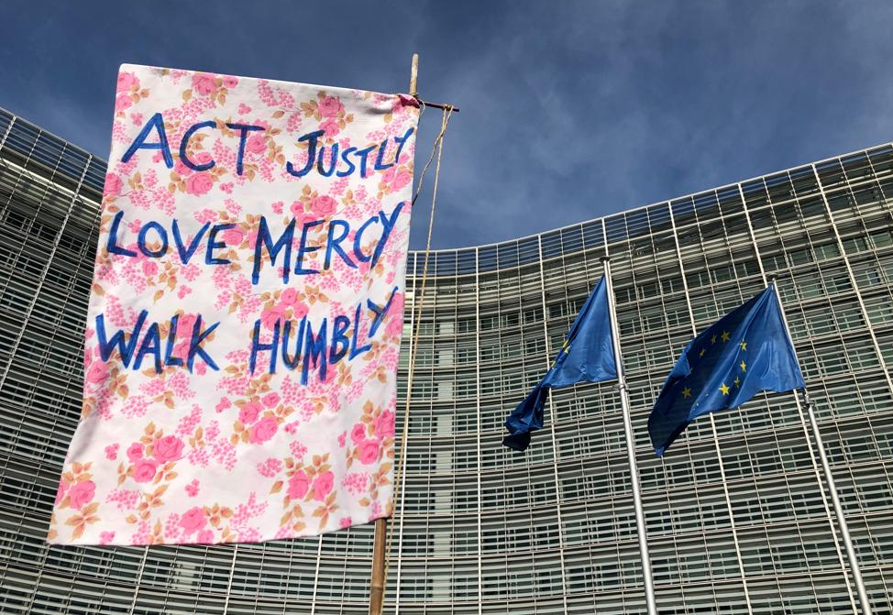

Slide 2
Caring for Creation
Barbara ALGER Net Zero Carbon Officer Diocese in Europe

Slide 3
Do you know your
carbon footprint?
If yes, enter it into the chat box.

Slide 4
Programme of Activity
Responds to December 2021 Synod motion
First phase of activity 2022-2024
Now second phase beginning 2024-2026
Based on National routemap
Adapted to specific characteristics of our Diocese

Slide 5
Diocese:
Planning and reporting
Support Communications and resources sharing
Carbon reduction plans for Diocesan offices
Updated travel policy
Seeking further resources

Slide 6
Archdeaconries:
Appoint Archdeaconry Environment Officer AEOs
Support network of LEOs
Training and mentoring
Regular follow up through Synod

Slide 7
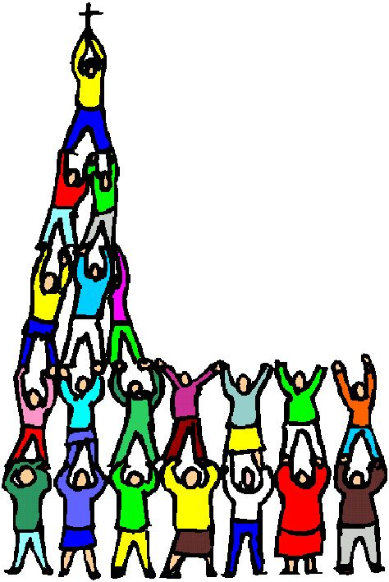
Chaplaincies:
Measure and report energy and emissions
Make a plan, appoint an LEO
Switch to renewable energy and energy efficient lighting
Engage with Eco Church

Slide 8
Diocese Commitment 1 - EcoChurch
Bronze Eco Diocese award
All chaplaincies
encouraged to join
Appoint a LEO
Regular point on Council agenda
Archdeaconry Creation Care network
Working together to Silver

Slide 9
Towards Net Zero Carbon by 2030
Diocese Commitment 2 - Towards Net Zero
Commitments:
Programme of activity to reduce carbon emissions
Measure progress
Share information, mutual support
Energy efficiency, renewables, buildings, travel, behaviour
Environment/climate criteria for investments/purchases
Pursue improvements urgently and continuously

Slide 10
Diocese Commitment 3 - Season of Creation
1st September – 4th October
Celebrate with range of activities
Use available resources
Repent, celebrate, commit
Ecumenical activities

Slide 11
Getting Strategic:
Importance of data for baseline, prioritisation and measuring progress
Just do it

Slide 12
Getting Carbon Literate:
The Climate Fresk
The Week
Videos Church of England
Carbon Confidence in one hour (CofE)

Slide 13
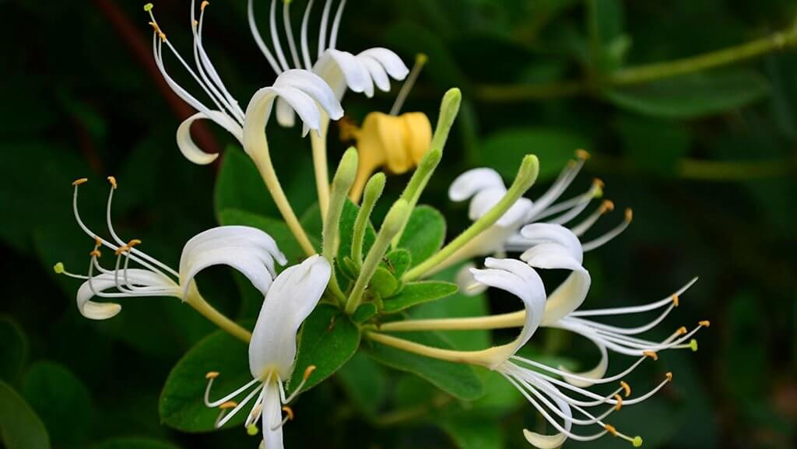
What else can we do?
Notes:
Some honeysuckle. Little drops of sweet ideas
Be on the lookout and call for:
- Communications - keep an eye out for the publications of the Diocese, use the Diocese and CofE websites. - When the archdeaconry gets an AEO, tell that person what you need. In the meantime, tell me and C4C group…
DATA LOVERS, documentalists, people who like the challenge of working with data. As we are handing out grants, we need a volunteer, someone to organize our files, our CMS. And young or old engineers who can create an app for our travel to make it easier.
SCIENTISTS, environmental, professors, published writers, to make periodic statements for the C4CWG about certain environmental problems, explain carbon emissions, tipping points, planetary limits etc.
BUILDING ENGINEERS: anyone involved in building energy efficiency, energy audits. Goal to coach various chaplaincies FUNDRAISERS We need to raise funds to hire more people, to build databases, to educate WITNESSES Church members from countries struck by the climate emergency.
To witness, to tell their stories. We need their point of view.
NATURE CONSERANCY: Our church members who are involved in nature conservancy, or who have contacts with local nature organizations. To teach gardening, composting, birdwatching to young and old. EDUCATORS Local climate awareness workshops. Bring them into your churches. Invite guest speakers, scientists, environmentalists, people who can teach your church members. PREACHERS: There has been a call to return to revive the work of Elizabeth Bussmann in facilitating the creation of lovely sermons on creation. Say, informal zoom workshops where preachers can in small chat rooms try out their sermons and get advice from others. For that we need some mentors and some learners, and any one person can be both. Elizabeth Bussman has started another Website if you haven’t seen it. LINK
COMMUNICATORS who can write up a fun article or make a cool video on what your church is doing to build awareness and to lower carbon emissions.
Conclusion
Lowering Carbon’s Emmissions is doing God’s work.
It’s cleaning up our mess.
It’s holy.
It’s loving God and neighbor

Slide 14
Useful resources 1. Treading lightly
EcoChurch Eco Church - An A Rocha UK Project
CofE Energy Footprint Tool Energy Footprint Tool | The Church of England
CofE Practical path to net zero carbon The practical path to net zero carbon for churches | The Church of England
360 carbon (comprehensive carbon footprint calculator) The Collaborative Carbon Calculator for Churches, Charities and Small Businesses • 360°carbon.org (360carbon.org)
A Rocha Ressourcés Archive - A Rocha InternationalA Rocha International
Green Christian Green Christian – Ordinary Christians, extraordinary times

Slide 15
Useful resources 2. Worship
Green Christian Green Christian – Ordinary Christians, extraordinary times
A Rocha At your service – Creation care resources for your church, by A Rocha International (arocha.org)
Iona Community Resources - The Iona Community
EcoCongregation Scotland Greening Worship (ecocongregationscotland.org)
New words to old tunes Hymns about Care of the Environment etc - Christian Ecology Link (christian-ecology.org.uk)

Slide 16
Useful resources 3. Networking & activism
Green Christian Green Christian – Ordinary Christians, extraordinary times
Christian Climate Action Christian Climate Action – Direct action, public witness for the climate
Christian Climate Action Belgium Home - Christian Climate Action Belgium
Craftivism collective Be a change-maker not just a world-worrier. - Craftivist Collective (craftivist-collective.com)
350.org (tools, guidance and training) 350.org
European Christian Environmental Network What's new | Ecen

Slide 17
Useful resources 4. Climate Science
IPCC IPCC — Intergovernmental Panel on Climate Change
Stockholm Resilience Centre Stockholm Resilience Centre - Stockholm Resilience Centre
Climate change learning resources A Collated List of Online Climate Change Learning Resources – SEEd (se-ed.co.uk)

